Slide 1
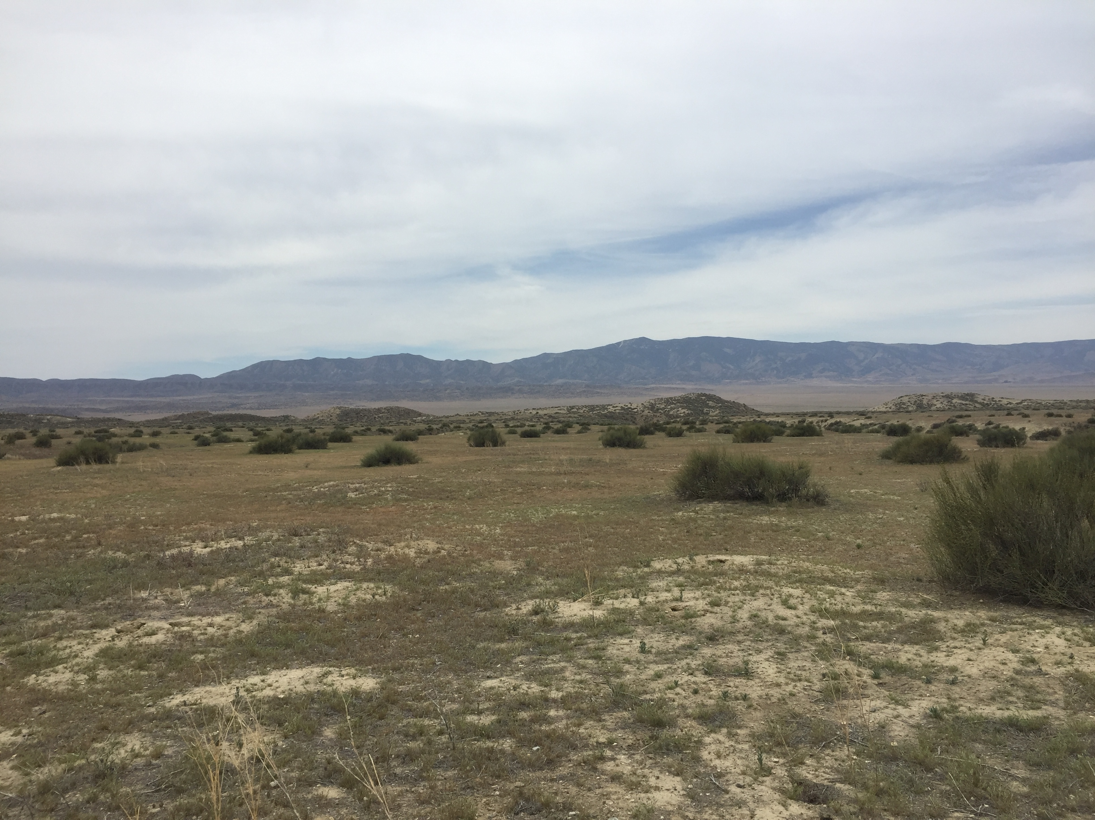
An examination of shrub and animal density-dependent interactions in desert ecosystems
By: Mario Zuliani
Dr. Chris Lortie
Notes:
Hello everyone. It’s a me Mario… and thank you for coming to my thesis proposal. I am planning on doing an examination between shrub and animal density-dependent interaction in the carrizo plain.

Slide 2

Chapter Timeline
Chapter | Title | Progress | ST Goals | LT Goals
1 | Making a deal with the Devil | Literature review started September 2018 | Collect preliminary data and have reviewed/analyzed by December 2018/January 2019 | Analyses complete by July/August 2019. Draft by September 2019?
2 | An examination of shrub and animal density-dependent interactions in desert ecosystems | Field Season to start May 2019 | Data analysis by September/October 2019 | Second field season May 2020?
Notes:
My overall timeline for the project is to conduct a systematic review, titled “making a deal with the Devil” for my first chapter and for my second, examining the density-dependent interactions of animals and shrub in field. This is just a brief timeline of short term and long term goals for this project.

Slide 3
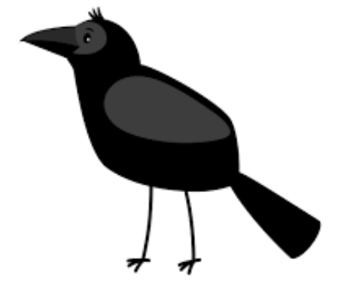
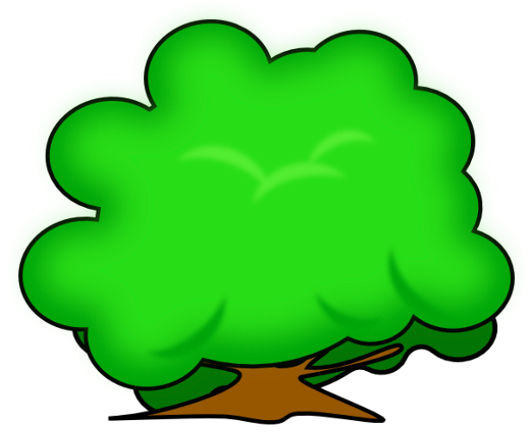
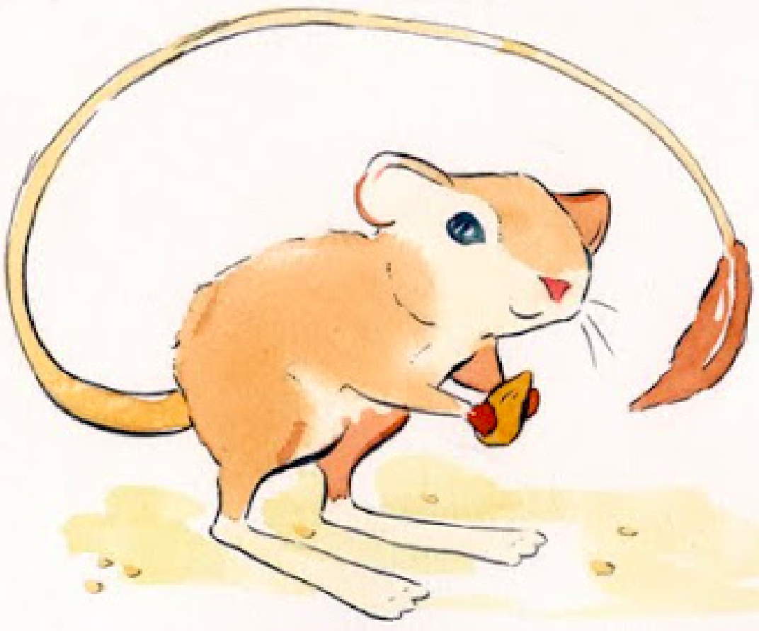
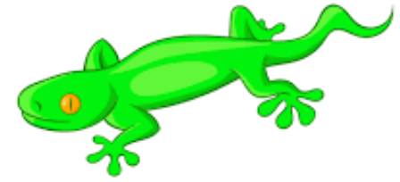
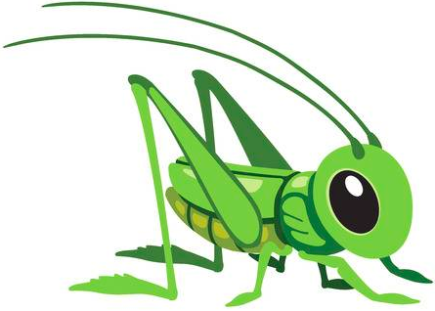
Background
Notes:
Positive interactions between plants and animal species have been reported in most ecosystems globally. This positive interaction is defined as a non-trophic interaction between species where at least one of the interacting species has a positive benefit to their overall fitness, and the other remains unaffected. The term most frequently used to describe this interaction is Facilitation. As long as one of the interacting species does not experience any negative effects that could hinder its overall survival. It is proposed that in arid environments (the type of environment I will be conducting my research) this interaction occurs much more frequently and that species in these areas would not be able to survive without this interaction.
Shrubs are able to facilitate these positive interactions with animal species by providing a variety of direct and indirect benefits . Direct interactions such as acting as a resource, protecting from predators and acting as a refuge, are jusr some minor examples of how these woody shrubs can benefit animal species. As for indirect interactions, shrubs provide a “microclimate” that are usable for species to escape the extreme heat in these arid ecosystems.
With these type of interactions in mind, it is possible that the total density of shrubs in an area could have a correlation with the animal density in these arid ecosystems.

Slide 4
High Density
Low Density
VS.
Notes:
Density is defined as the total number of individuals in a given area, per unit area. Therefor shurb and animal densities van be defined as the total population of a shrub or animal population in a given area. The density of shrubs in these arid environments vary heavily from area to are. In some, there may be as many as 5 shrubs in a 10m radius. IN contrast, there could be 0-1 shrubs in the same area. There has been a significant lack of studies conducted on the relationship between shrub density and animal density, especially in these arid ecosystems. It is possible that due to the facilitation that occurs between shrub and animal species, that a higher shrub density can have an affect on the total animal densities in these areas.

Slide 5
VS.
Notes:
Animal Density in ecosystems is important for the individual animals species. If we have a higher density of a specific animal species, then there is a higher chance for interactions to occur between them. For example, there can be higher chances of individuals mating when the population density of that specific species is fairly high. However with this increase in animal density, there may also be an increase in competition for food supplies and possibly predation. This is opposed to lower animal densities. With a lower density of animals, there may be less competition for resources and a decreased predation, however there will also be a decreased in positive intraspecies interactions, such as mating. It is evident that these differences in animal density will have an overall impact on the species in the area and will have influence on their interactions and survival. Studying and understanding the link between these animal dependencies and the corresponding interactions allows for a better plan to be formed for restoration purposes in arid ecosystems.

Slide 6
Chapter 1: Making a Deal with the Devil
Purpose:
A systematic review to gain insight on the relationship between shrub and Animal densities recorded in literature
Focus on papers where facilitation occurs and if densities are recorded
Questions:
What activities are being observed with shrubs?
If there are interactions then is only one species benefiting?
Direct and indirect effects?
Are shrub and/or animal densities recorded?
Notes:
My chapter one is going to be a systematic review focusing on gaining insight on the relationship between shrub and animal densities in literature. The main focus will be to see if literature that touches upon facilitation included densities in its records. The main questions that will be focused in during this review will be Read questions

Slide 7

Chapter 1: Making a Deal with the Devil
Predictions:
Many studies are going to focus solely on benefactor interaction
Costs to helper species will be overlooked in most papers
Shrub densities will not be focused on or included
Methods:
Web of Science Screening
Generation of bar graphs and PRISMA
Zotero Paper loading
Screen eligible papers
Systematic Review write up
Notes:
State predictions In order to find articles usable for the systematic review, Web of Science was used to begin with the preliminary screening of potnetial literature. Use of key words such as shrub* facilitate* density* arid*, etc were used. From there bar graphs were generated to compare the number of papers associated with different combinations of key words and a PRISM to help display the filtering process of potential literature that will be used.

Slide 8
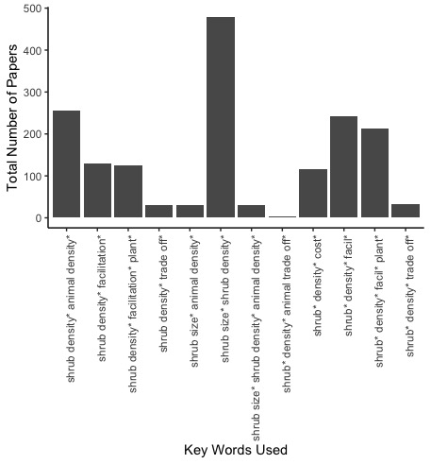
Chapter 1 Progress to Date: Literature Search
Notes:
Some progress to date that I have been working on. I have already begun initial screening of potential texts to use for the systematic review. The figure shows the variety of combination of key words used to find these papers. The main thing to take from this is that at a large scope there are hundred of papers, as seen through the search with the key words shrub size* and shrub density*. However as the scope decreases to more specific words for this chapter, the number drastically decreases, as seen from the shrub* density* animal trade off* portion. Side note I believe that this was significantly lower due to searching the key phrase animal trade off*. I believe the best way to search for papers relevant to my research question would to be using a combination of the key word searches.

Slide 9
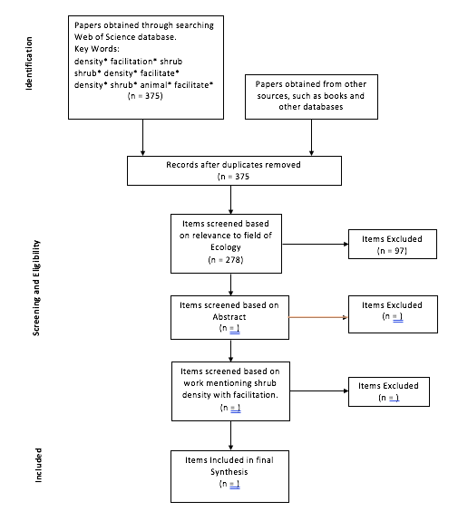
Chapter 1: Progress to Date: PRISMA
Notes:
The PRISMA generated shows the search for key words so far. I decided to focus in studies with word combinations including; density* facilitation* shrub*, shrub* density* facilitate*, and density* shrub* animal* facilitate*. From there I found that there was 375 studies total with those combination of key words. After filtering for duplicates I camer to the same number of studies. In addition I filtered out papers that do not pertain to the field of Ecology, such as cellular biology AND BUSINESS, and focused on just the field of ecology. As for progress to date, that is as much of the screening process that has been done. My plan is to continue this throughout December and January where the Abstracts will be screened, then the full body of texts before the final papers are decided.

Slide 10
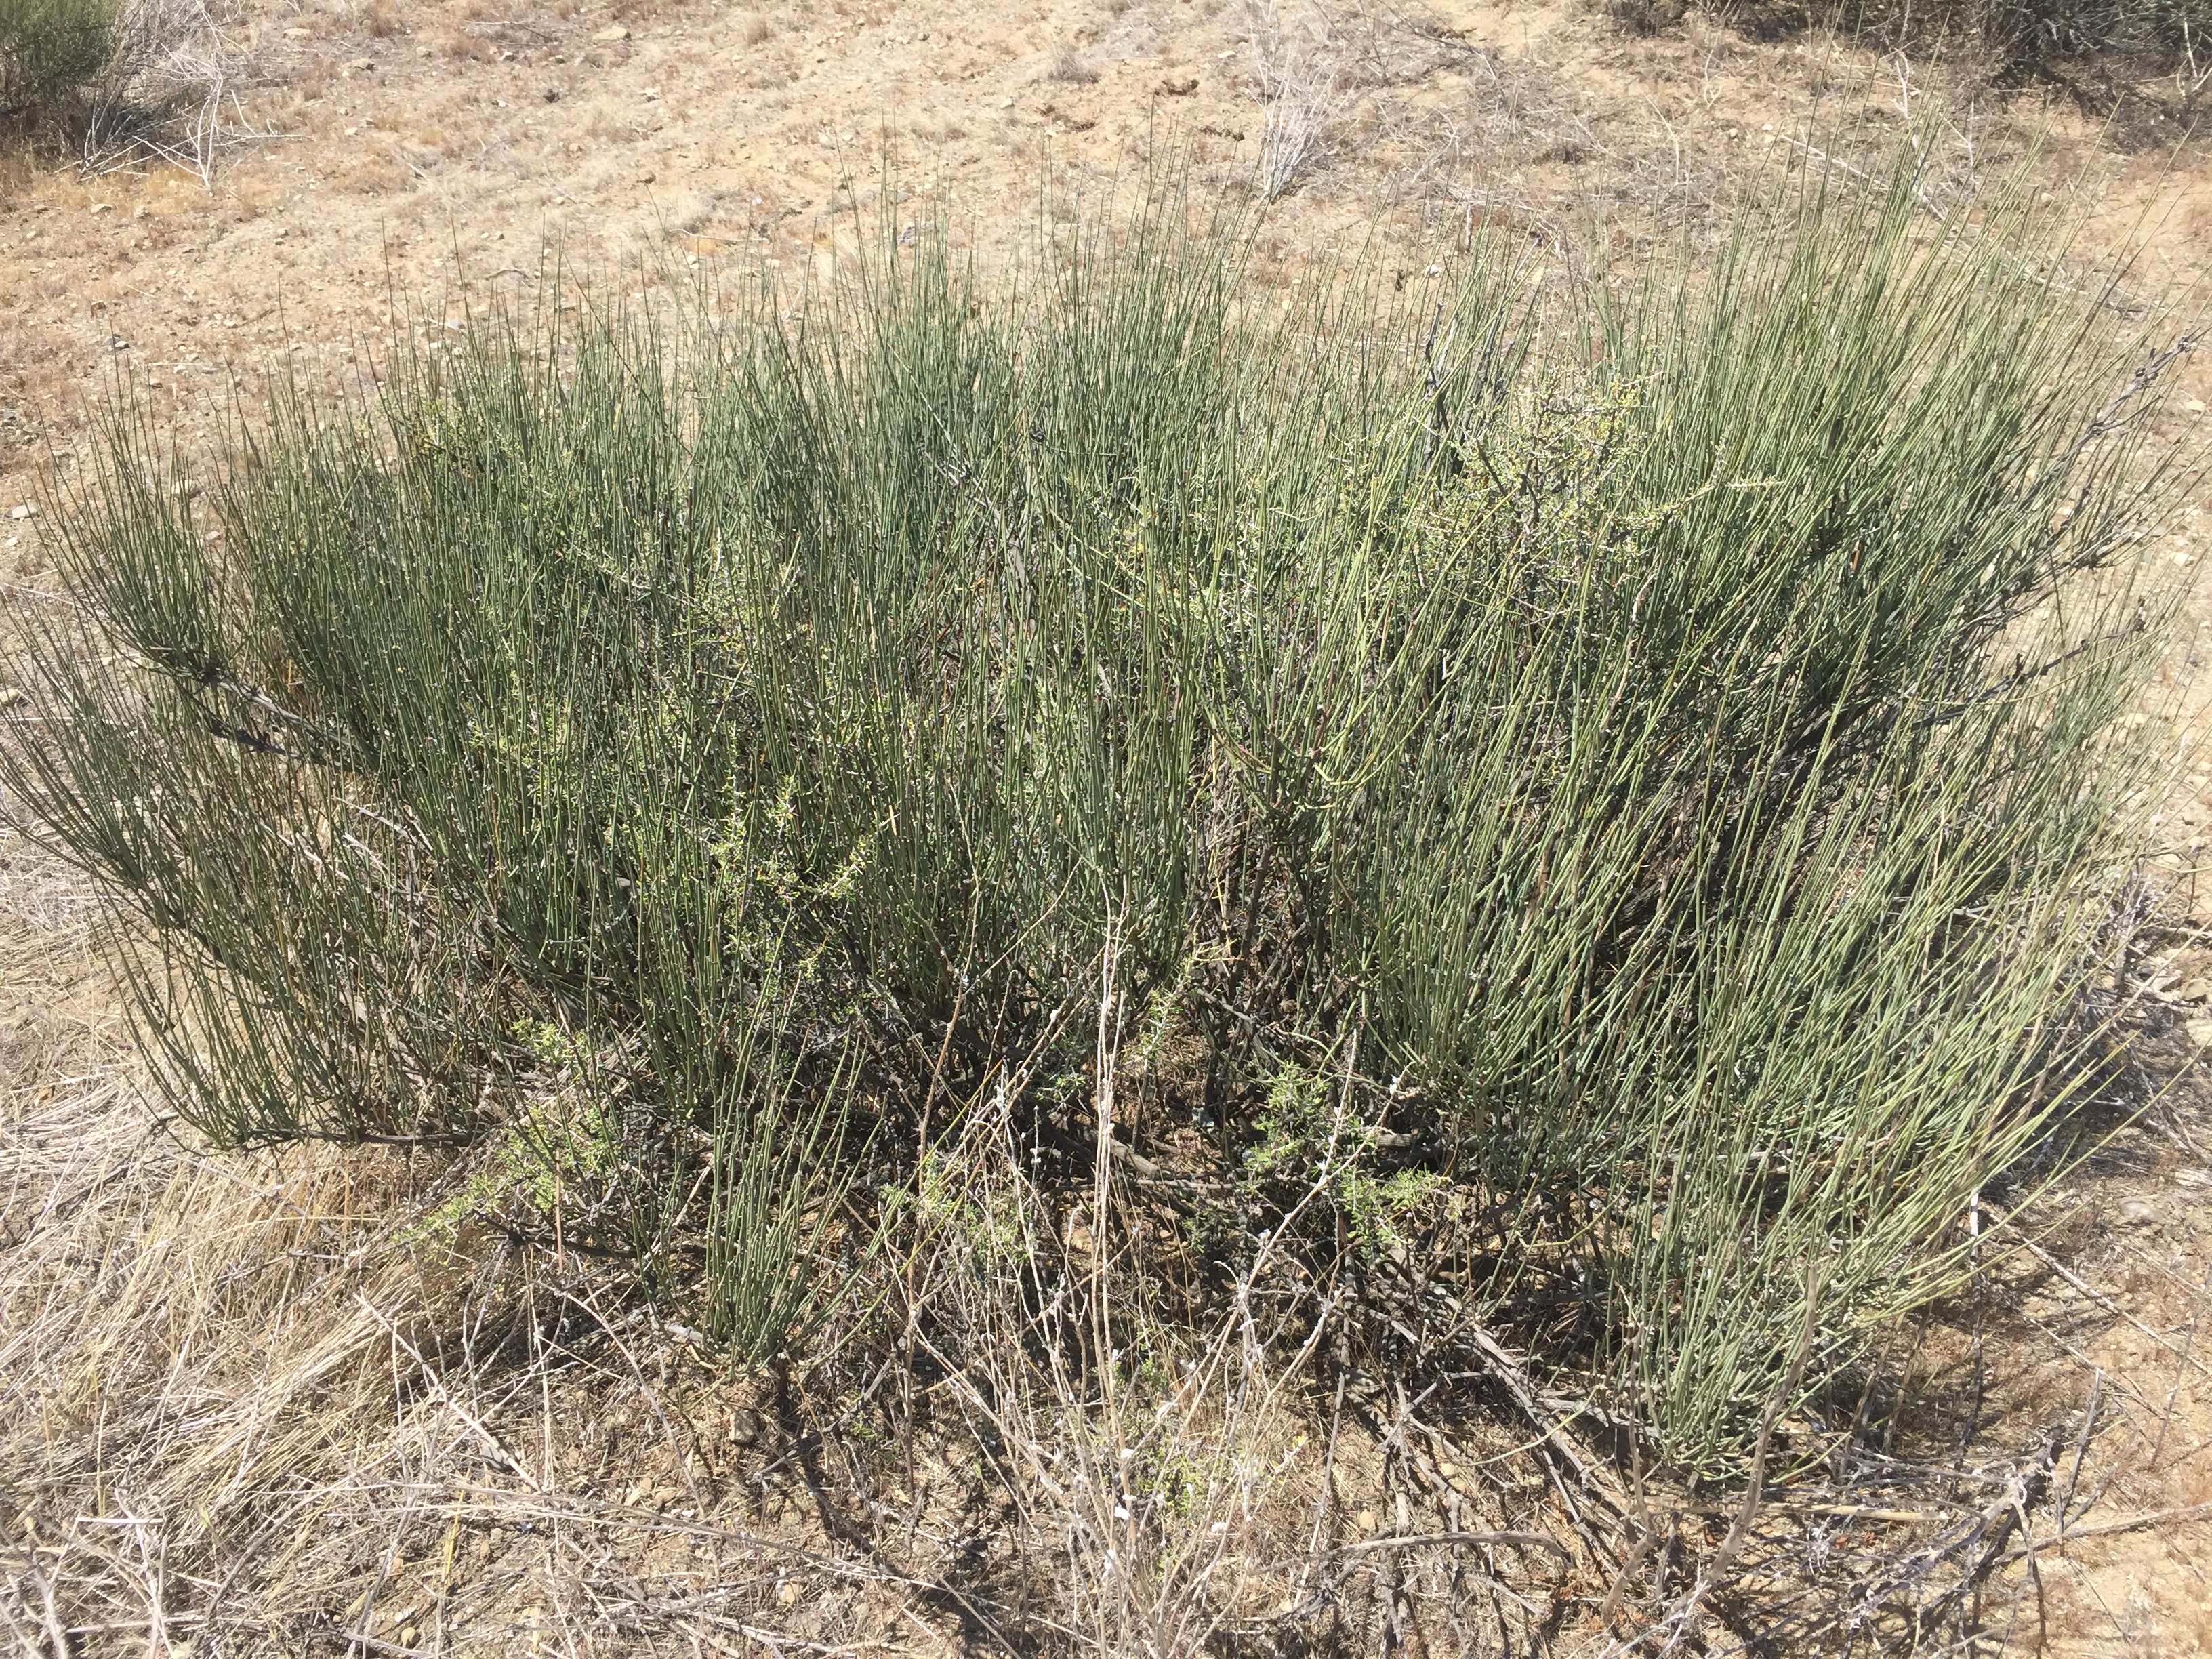
Chapter 2: Shrub and Animal Density Correlation in Desert Ecosystems
Notes:
For my Chapter 2 I will be going into the field to measure the Shrub and animal densities in the Carrizo plain. The main shrub species located in this desert is the Ephedra Californica. It is a foundation species important for the restoration of deserts in California. Studies have been conducted to look at the interactions between this shrub and various animal species located in this ecosystem. Species such as the blunt nosed leopard lizard, use this shrub’s canopy cover to escape the intense heat at peak hours of the day, and species use the many burrows located near the shrubs as refuge from other animals. After mechanical damage is done to the shrub, it is found to recover, even during periods of drought, showing the resilience of this species inits native habitat. The interactions that are associated with this plant species, along with the population densities of the species that it interacts with, will be the major focus of the study.

Slide 11
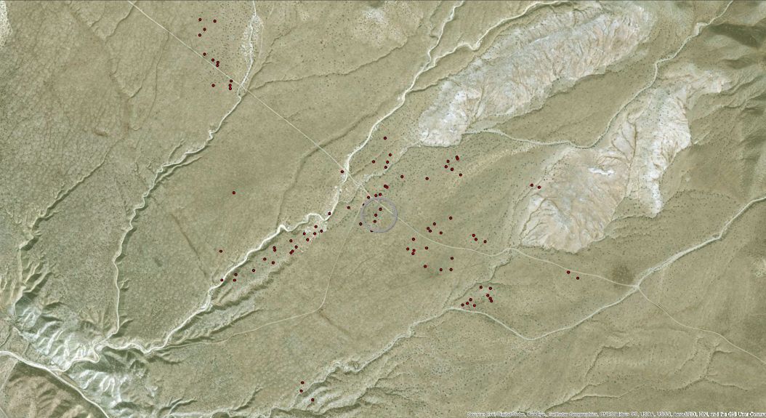
Study Site
Notes:
The Carrizo Plain is located in California’s San Joaquin Valley and is about a 190km drive south to Santa Barbara. Its coordinates are 35.1899° N, 119.8633° W. The area receives a very low amount of precipitation, just below 15cm. The total size of the site is approximately 820km². The main area that will be focus on in the site is the Elkhorn Plains, which are located at the southeastern portion of the monument. The most dominant shrub in the area, and the one that is being focused on, is Ephedra Californica.

Slide 12
Chapter 2: Shrub and Animal Density Correlation in Desert Ecosystems
Purpose:
Discover trends in shrub and animal population densities and to distinguish possible correlations between them.
Question:
Is there a relationship between the shrub density and animal density in the Carrizo Plain?
How are the varying species interacting with the shrubs?

Slide 13
Chapter 2: Shrub and Animal Density Correlation in Desert Ecosystems
Hypothesis:
There will be a correlation between shrub density and animal density, due to beneficial interactions between the two groups
There will also be a relationship between varying species abundance
Predictions:
Higher Shrub density should correlate to higher Animal density
Visitation in high shrub density areas should be higher than in low shrub density areas
Camera capture rate should be much higher than low density

Slide 14
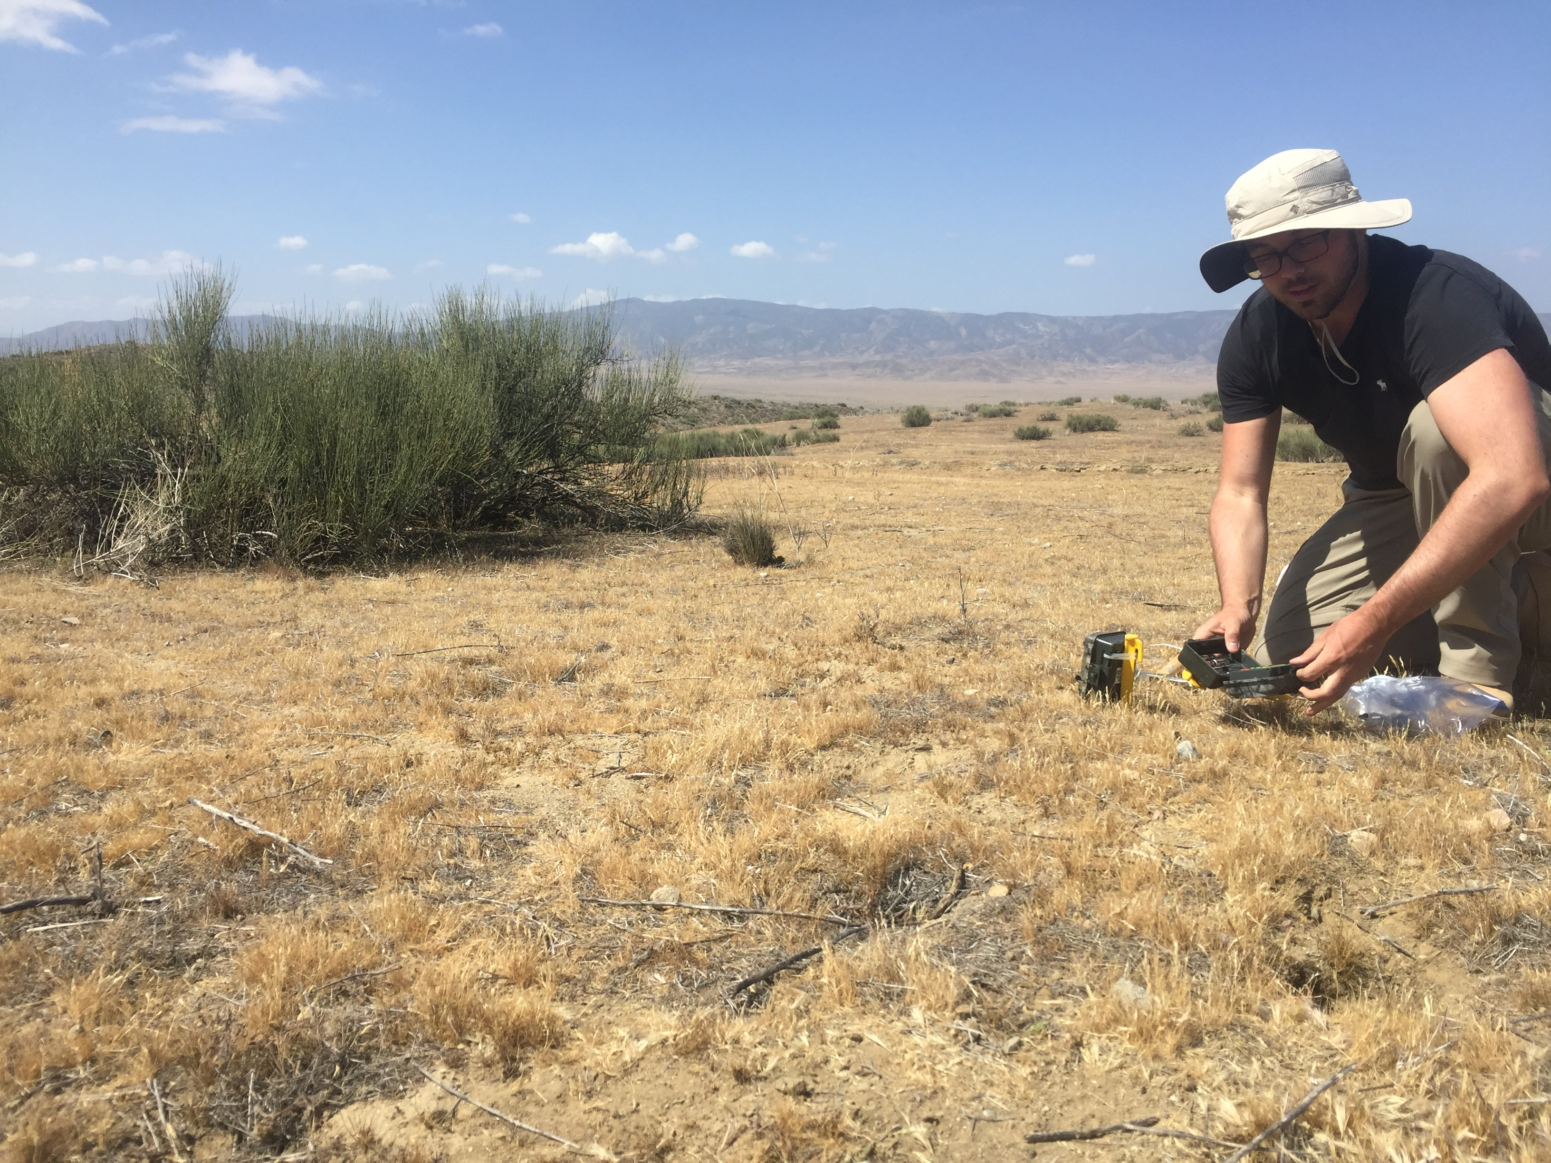
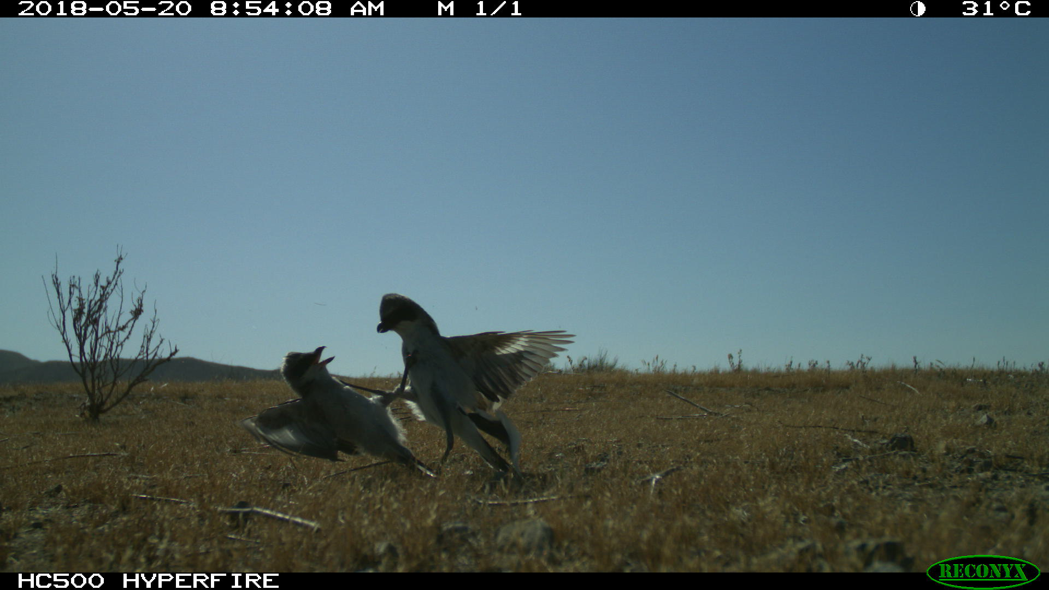
Chapter 2: Shrub and Animal Density Correlation in Desert Ecosystems: Methods
2 Sites x 3 density gradient (Low, Medium, High) X 2 (Shrub vs Open) x 10 Reps = 120 Sets of data
Notes:
Camera Traps
The main portion of the experiment is going to be conducted using camera traps. There traps are going to be deployed at 2 separate sites on the Elkhorn plain. From there, separate microsites will be established ranging from high shrub density to medium and then low. After searching through literature, there is no gradient for this established so the main concern will be to establish a gradient like this.
So for camera set up there are 2 sites, at each site im hoping to have a High, medium and low density microsite each with their own set of camera. Each set of cameras will have 2 traps, one facing towards the shrubs and one away from them. Finally this is to be repeated 10 times, resulting in about 120 Sets of data. The cameras will be changed every 3 days for the duration of a month.
Cameras will be set to the video function and will have a 5 second run time when triggered by movement. Once cameras have been removed and the corresponding SD cards are labeled and downloaded onto a hard drive, an excel sheet will be generated and used for data analysis. The sheet will consist of: date, rep, day, week, microsite (O/S), animal.hit, RTU, time.block, actual.time, start, stop, behavior, and observations

Slide 15
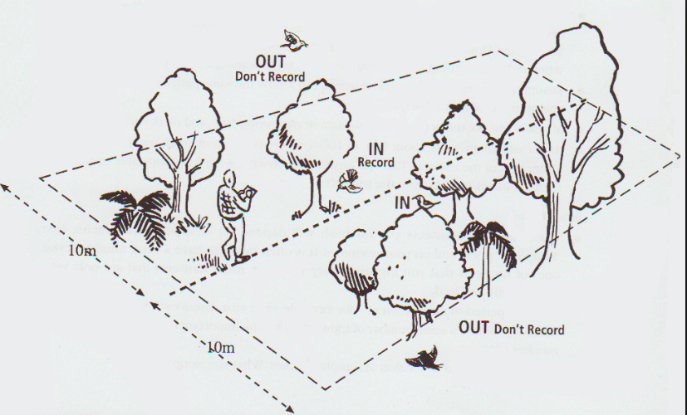
Notes:
TRANSECTS!
While Camera traps are deployed in the field I plan on running around 9 transects at each site, 3 per microsite for a total of 18 transects. They will run a distance of 100 meters and have an observational radius of around 10m. While conducting the transects any animal species (for example grasshopper, fly, bird, etc) that is within this transect will be counted towards the dataset. Anything outside will not (A typical transect). When an animal is located on the transect then the type of animal will be recorded as well as distance on transect, behavior and distance from closest shrub. In addition, the shrub density within the 10m radius will be recorded every 2m along the transect. These transects will be run every 3-4 days for the duration of a month.

Slide 16
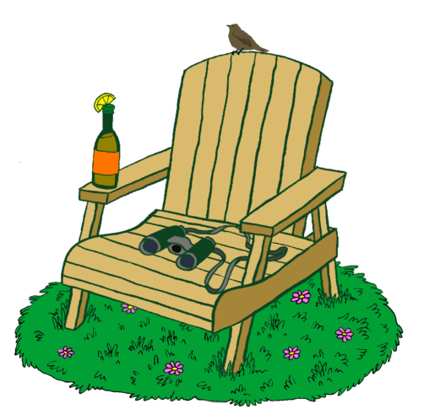
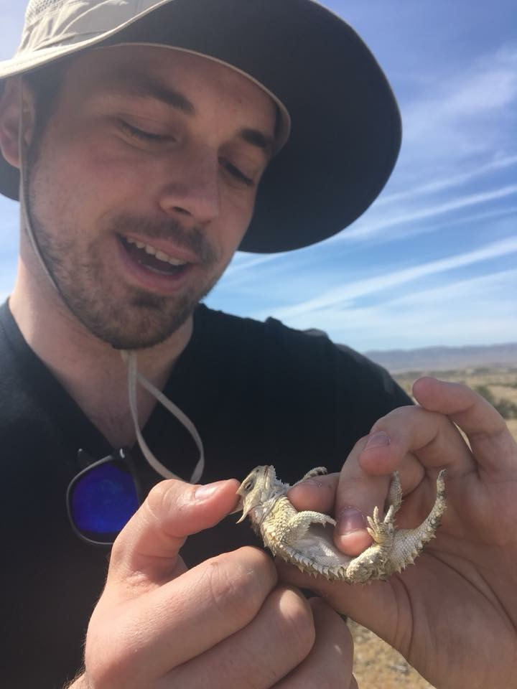
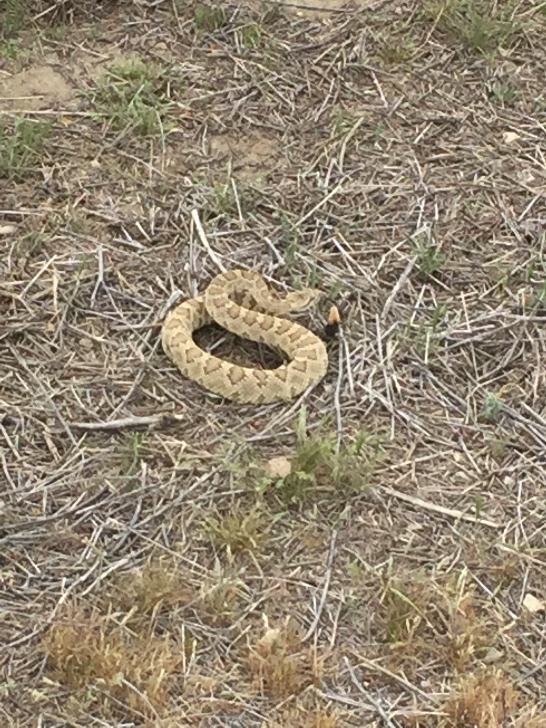
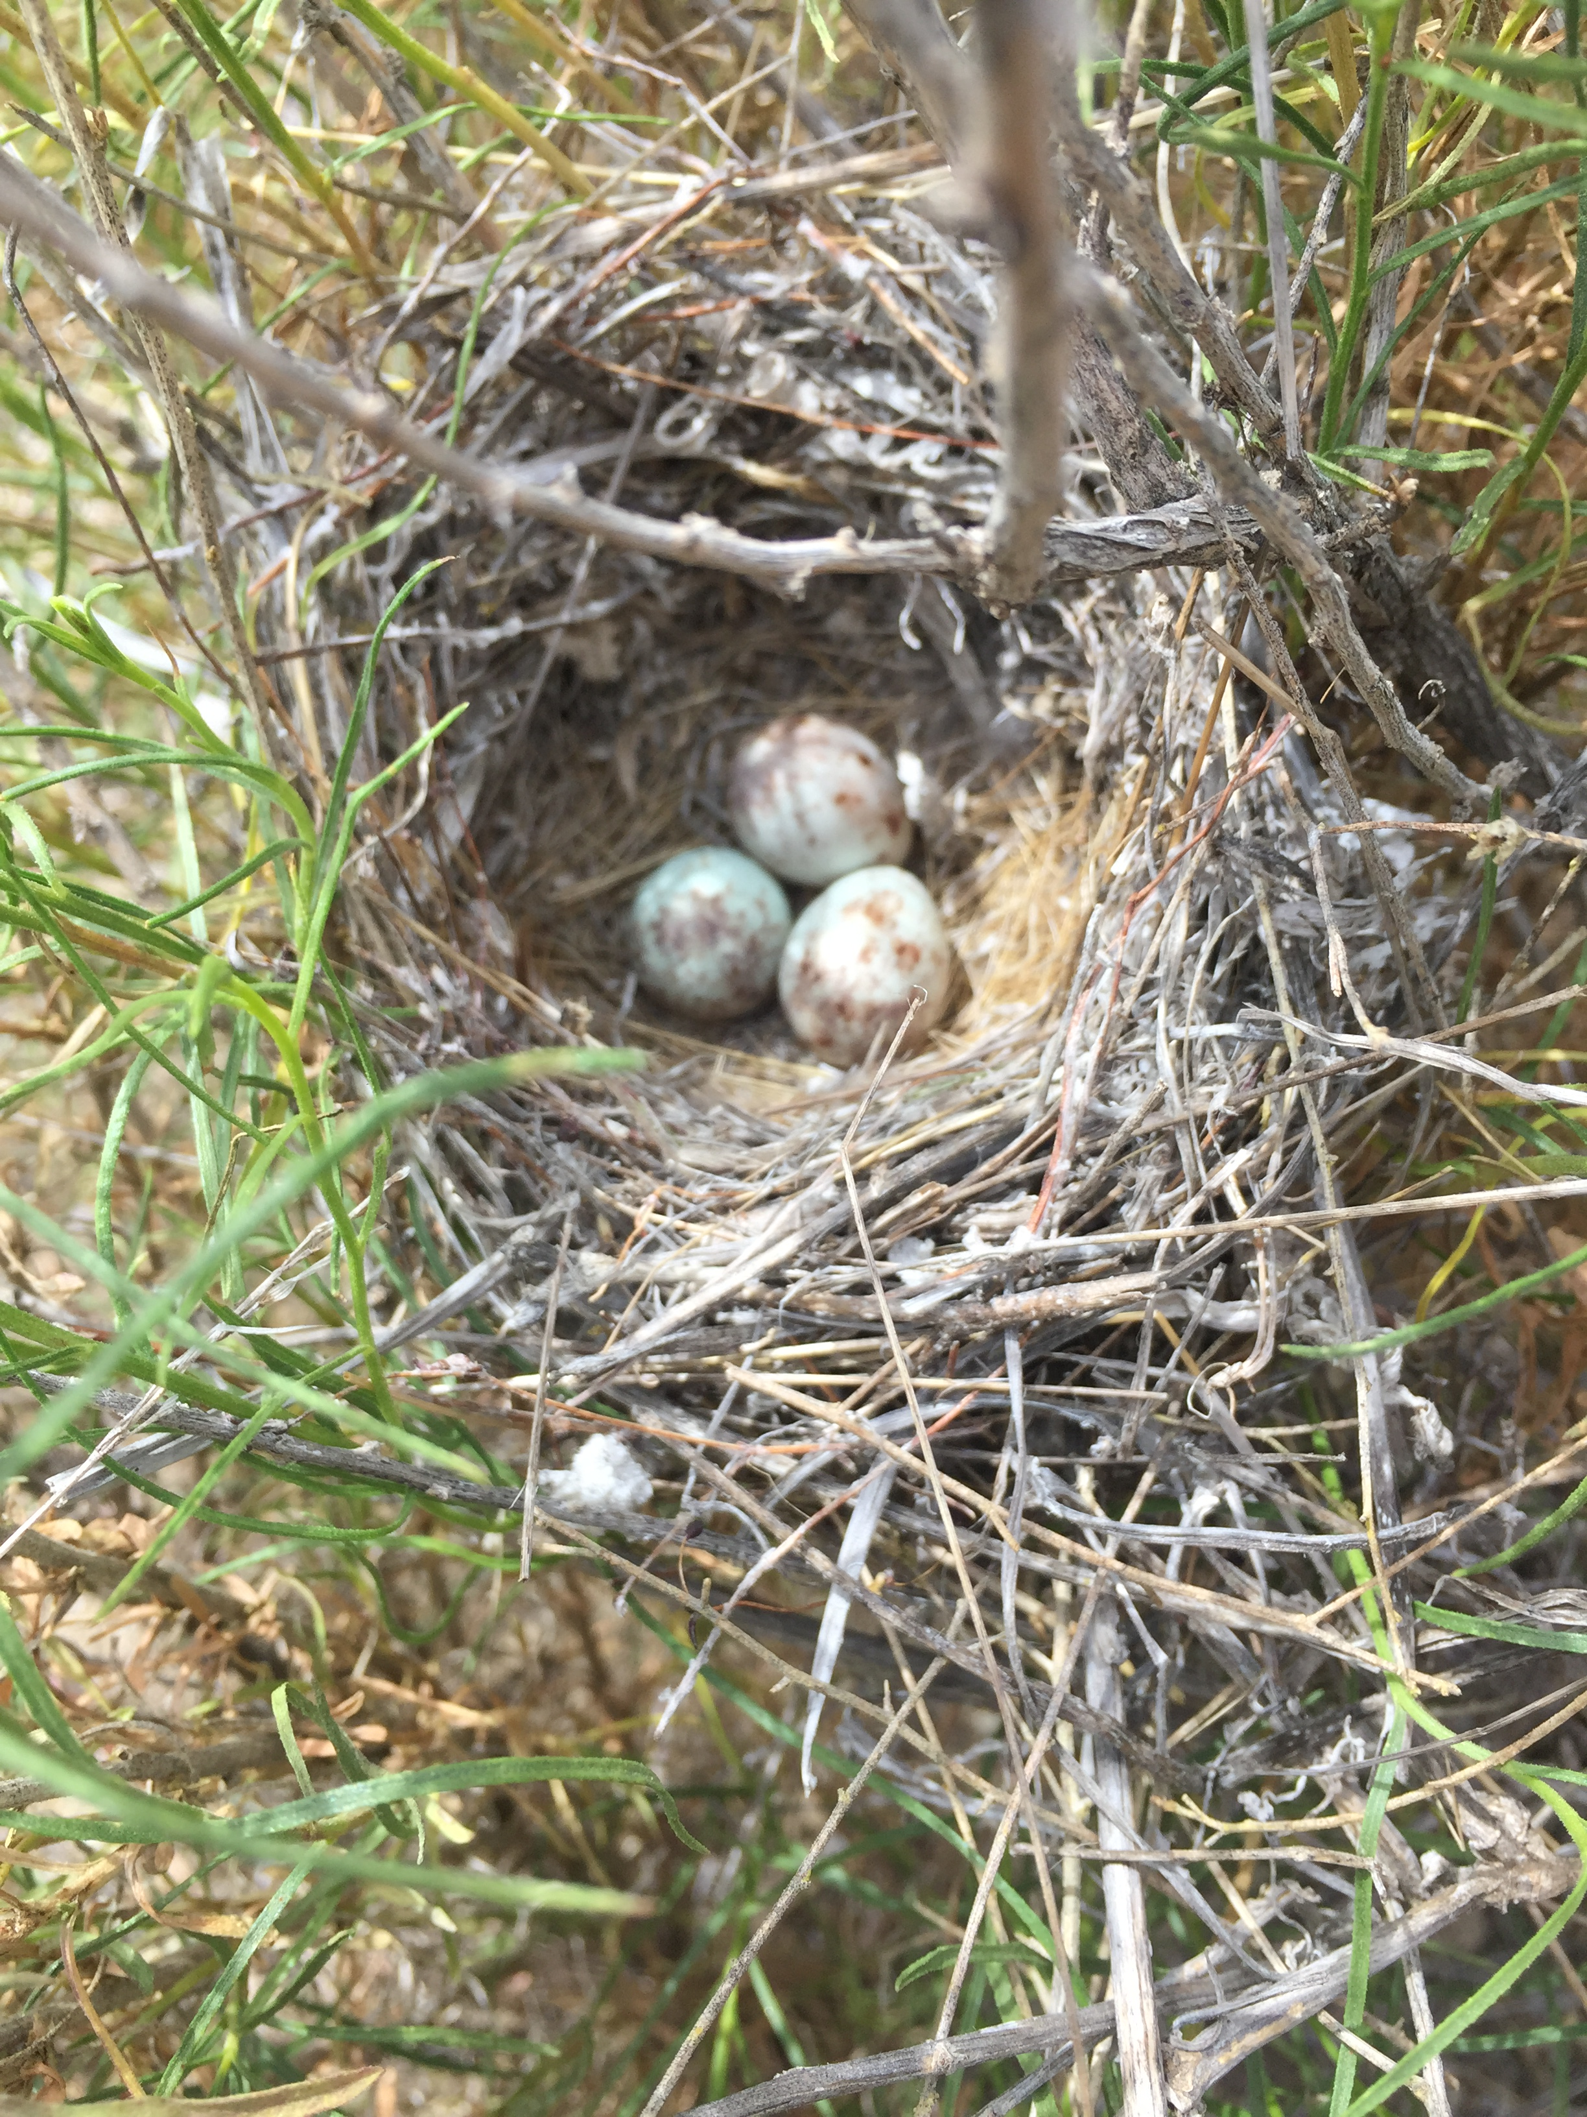
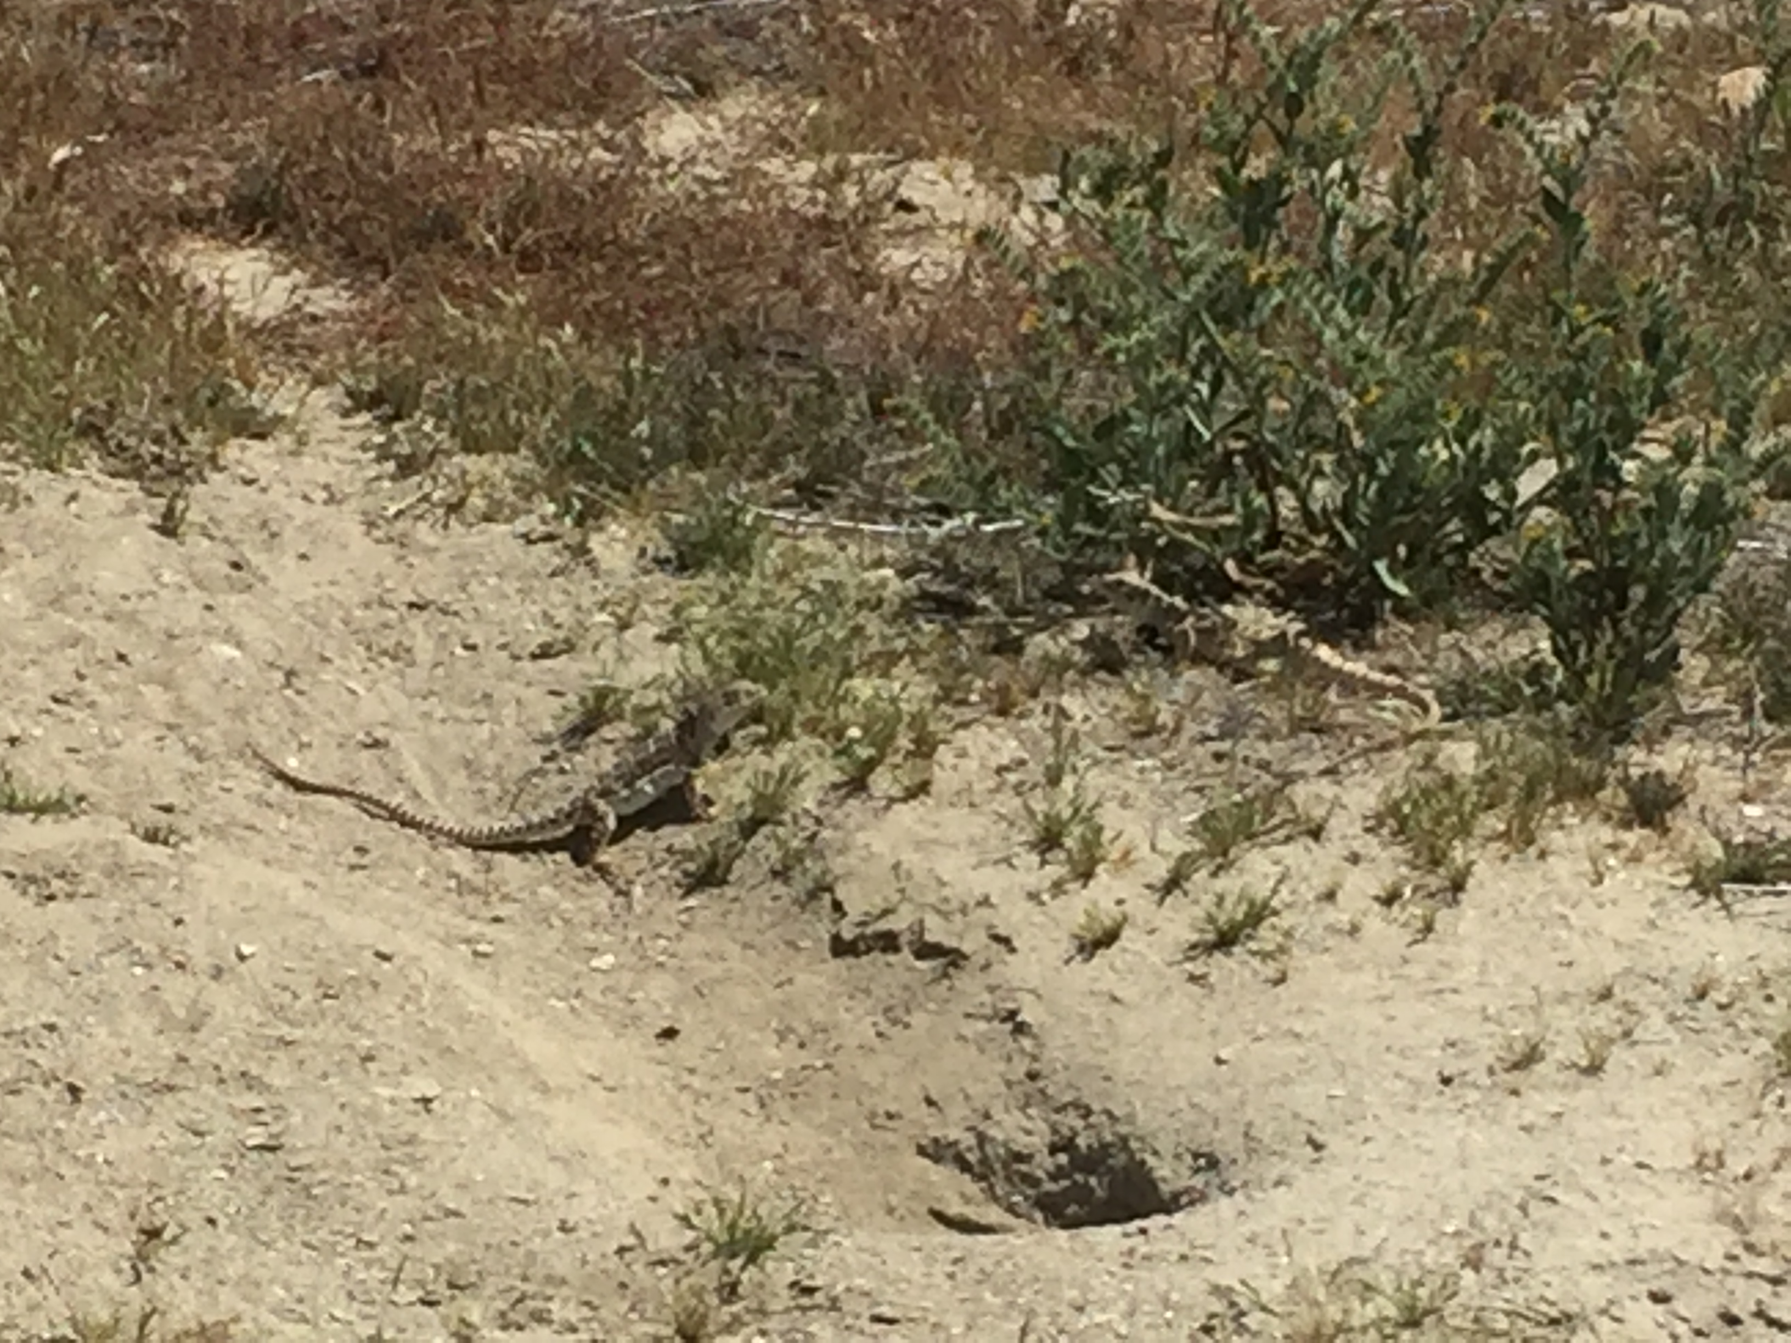
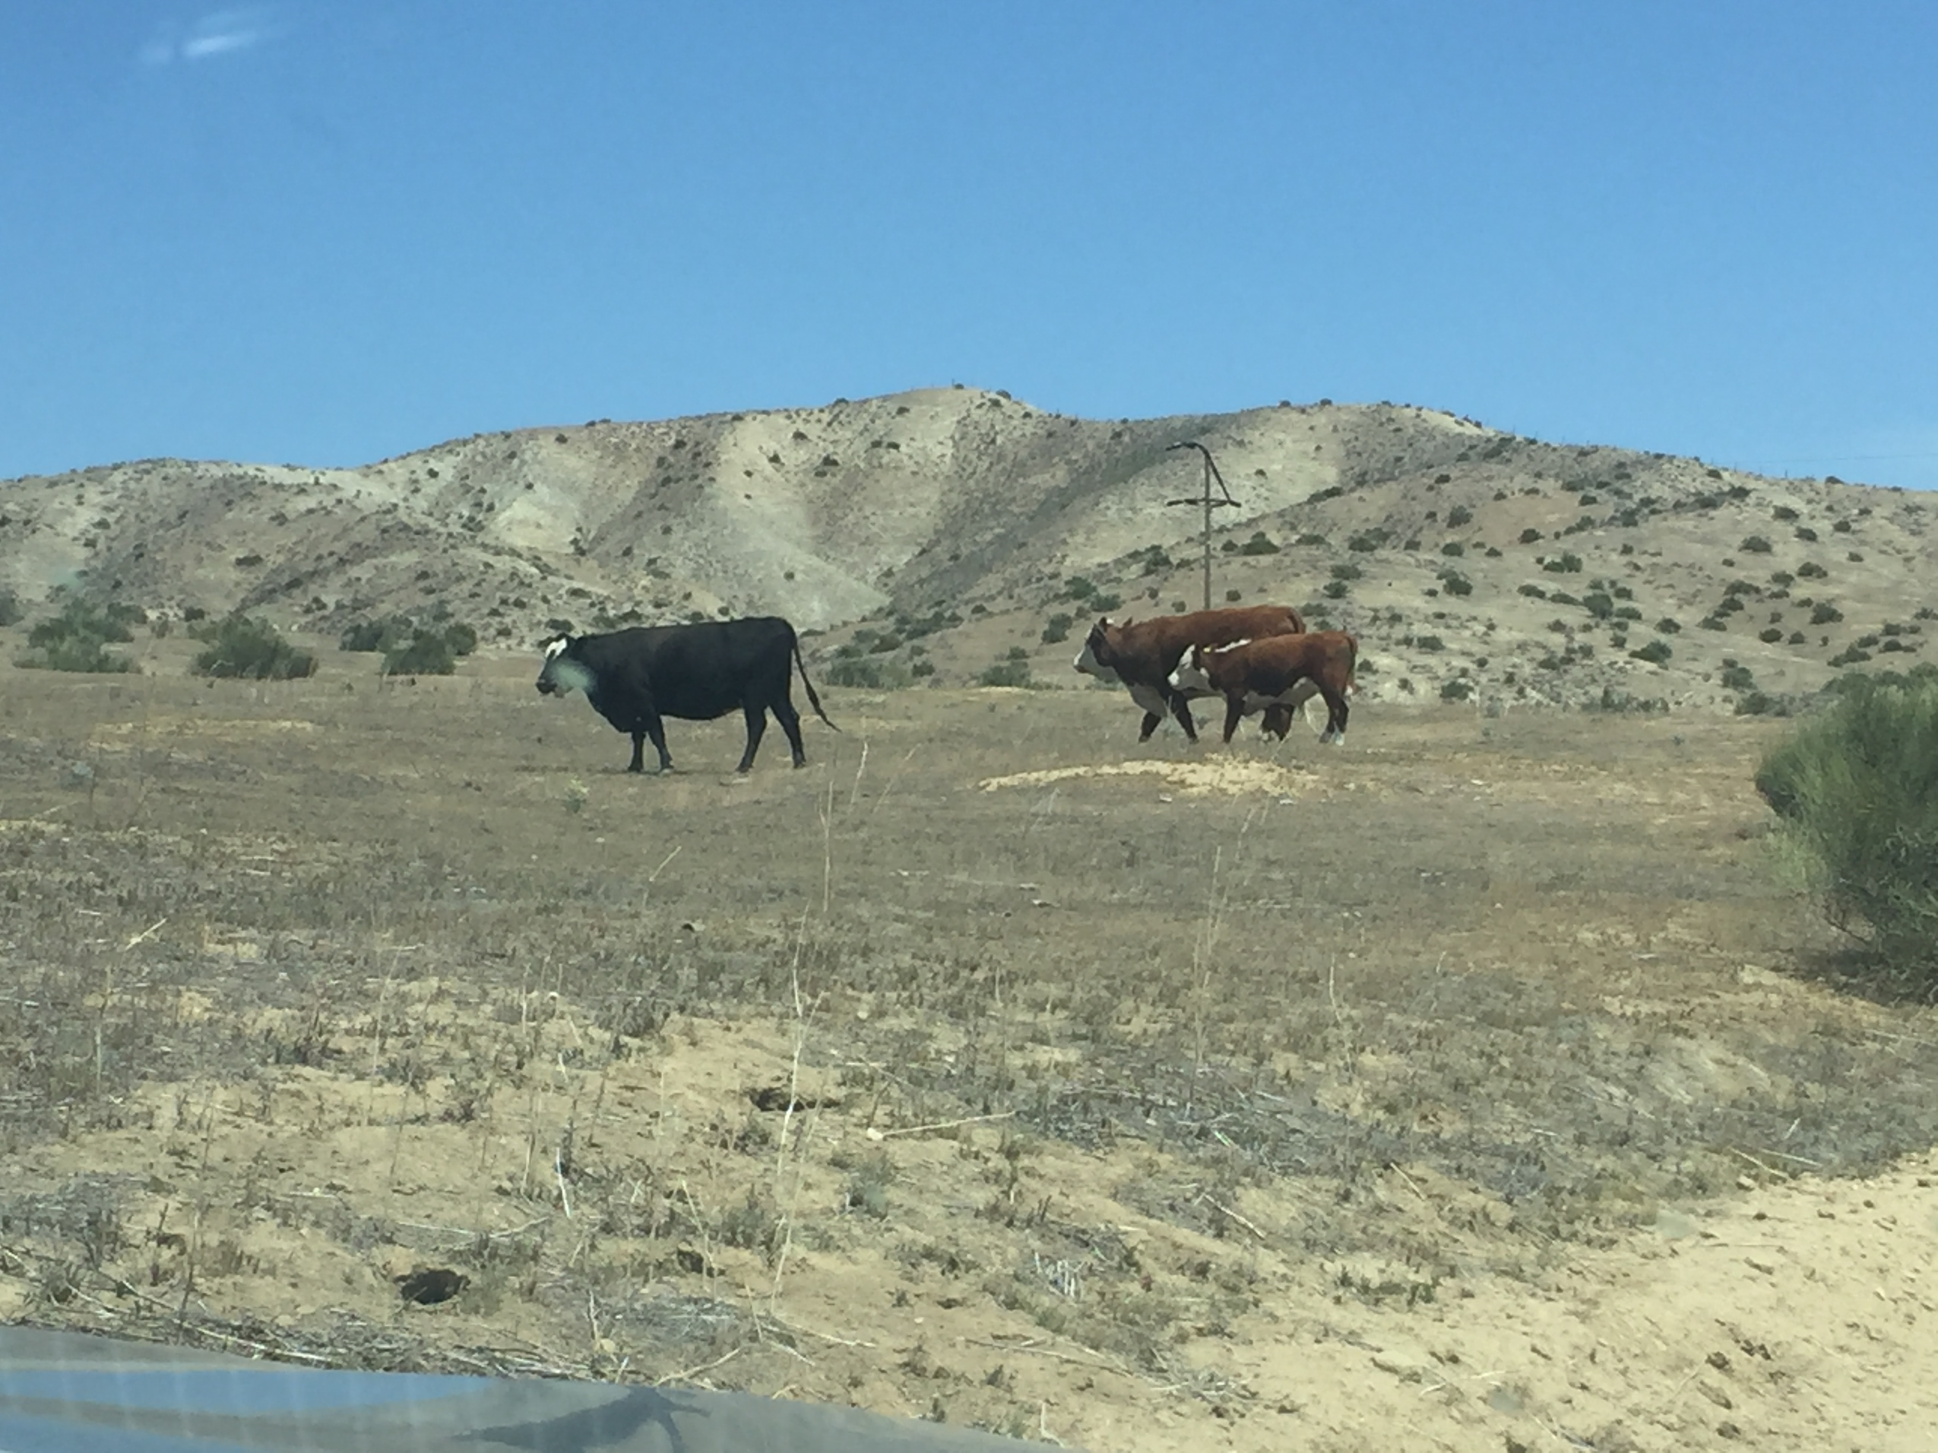
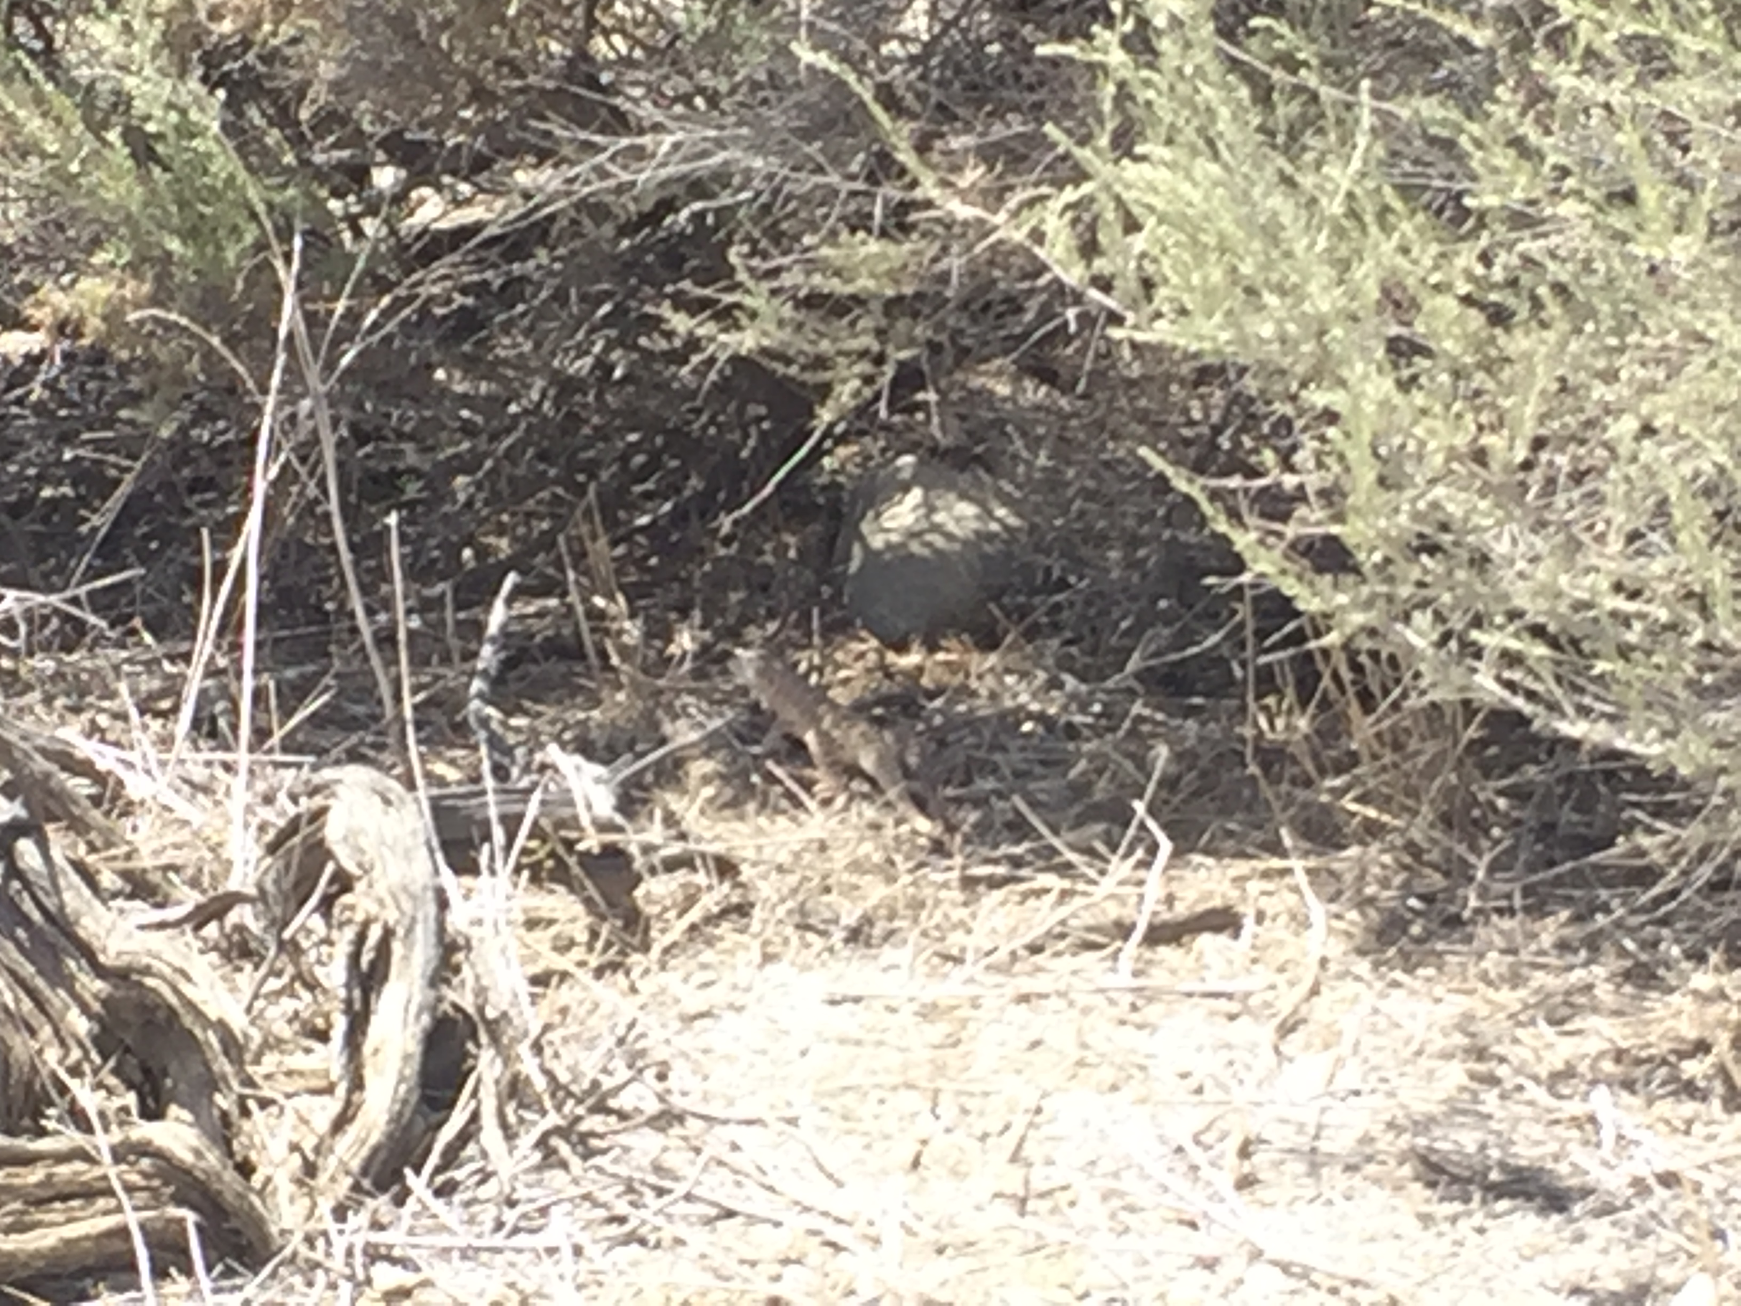
Notes:
Focal Observations
For focal observations I plan to spend several hours at each of the main sites to observe and record data on the various animal species in the sites. I will include data such as species, GPS coordinates, behavior, time, general proximity to shrubs and if possible shrub density. This will be conducted during the same time as the Camera traps are deployed at each Microsite as to collect as much data on the species in each area as possible.

Slide 17
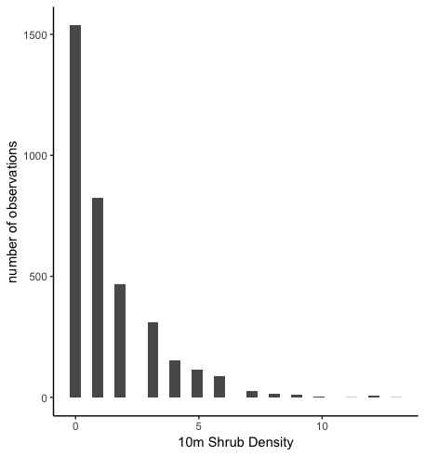
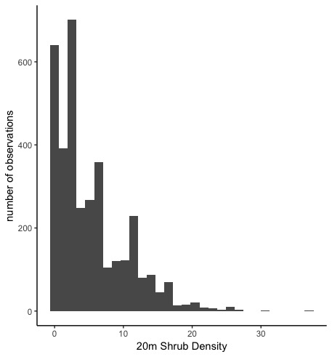
Progress to Date
Notes:
Progress to Date
The two histograms display the difference in shrub densities in a 10m radius and a 20m radius. It is evident from the two figures that as the field of view increases from 10m to 20m, the total shrub density increases quit a bit. This suggests that As there is a difference in shrub densities in this ecosystem, it just depends on the range of view that is used.

Slide 18
Implications
Studying the relationship between shrub density and animal density can lead aid in the restoration and management of desert ecosystems. Knowing the density of foundational shrubs needed to restore an area and which areas to preserve, can save a significant amount of money and effort during restoration

Slide 19
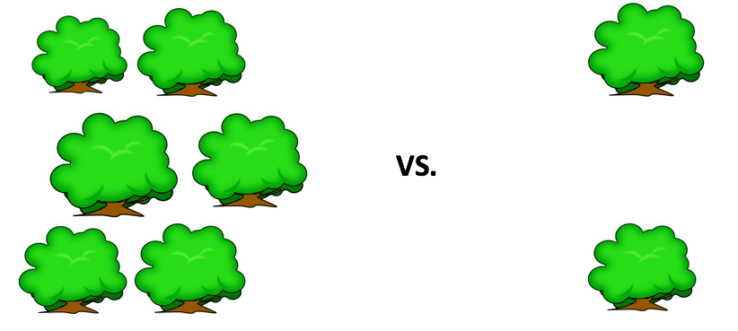
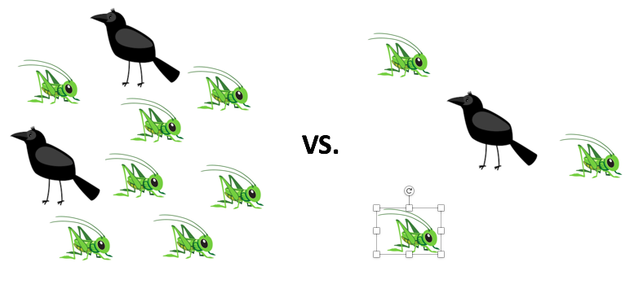
Link Between Densities
VS.
Notes:
The main implication of linking shrub and animal densities together is to determine if it is a viable way to aid in restorative efforts in desert ecosystems. If it is found that higher shrub densities correspond to higher animal densities, then perhaps the best way to help increase populations of animals in these ecosystems (especially since many of which are endangered) would be to increase the total density of these foundation shrub species. In contrast, if we find that the shrub density does not have any correlation to the total animal density in an area, then we know that introducing more foundational shrub species may not increase the overall animal densities.

Slide 20
Indepth Timeline
Timeline | Goals
February 2019 | Travel to Carrizo study site to get preliminary data on potential sites. Pick potential sites.
March 2019 | Work with data collected from February trip.
April 2019 | Continue working with data collected from February trip, work on write up for Chapter 1
May 2019 | Travel to Carrizo site, acquire camera traps and SD cards. Deploy cameras at sites (Chosen in February). Conduct focal observations and transects
June 2019 | Return from field site. Begin analyzing data from camera traps, transects and focal observations. Continue work on Chapter 1 if not yet completed
July 2019 | Continue working with dataset from May field month. Continue work on Chapter 1 if not yet completed.
Notes:
Go over timeline

Slide 21
Thank You! ☺

